Slide 1
Impact of Socioeconomic Factors on Health Outcomes
Presented By: The Four Loopers
Hali Bielser, Kristen Harnack, Mindy Ketchum & Brittany Oullette

Slide 2
Motivation & Summary
Notes:
After determining sources, had to bring all data together to perform desired analysis

Slide 3
What factors affect preventable hospitalization?
Weather
Income
Parks / Recreation access

Slide 4
Original Hypothesis
If a city has poor socioeconomic factors, then the preventable hospitalization rates will be higher than cities with more favorable socioeconomic factors.

Slide 5
Data Exploration and Clean Up Process
Research Sources and Gather Data
Cleanse and Prepare Data
Transform and Develop Data
Correlations and Outcomes

Slide 6
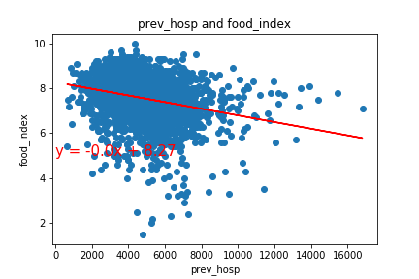
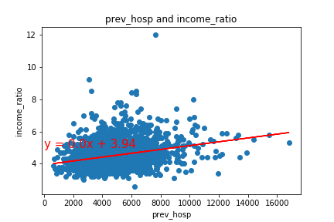
Unsatisfactory Findings

Slide 7
Questions & Data
Notes:
After determining sources, had to bring all data together to perform desired analysis

Slide 8
Adjusted Question
How is a county’s fair health score impacted by various environmental and social factors?
If a county has poor socioeconomic factors, then the poor or fair health percentage will be greater than counties with more favorable socioeconomic factors.
New Hypothesis
Notes:
Fair Health: Poor or Fair Health measures the percentage of adults in a county who consider themselves to be in poor or fair health.
https://www.countyhealthrankings.org/explore-health-rankings/measures-data-sources/county-health-rankings-model/health-outcomes/quality-of-life/poor-or-fair-health

Slide 9
Questions – "Is there a strong correlation between.."
Fair health percentage and the type of food nearby?
Fair health percentage and excessive drinking?
Fair health percentage and physical activity?

Slide 10
Data
County Health Records (www.countyhealthrankings.org)
Latitude and Longitude by county to locate points of interest (data.healthcare.gov)
Points of Interest (Google)

Slide 11
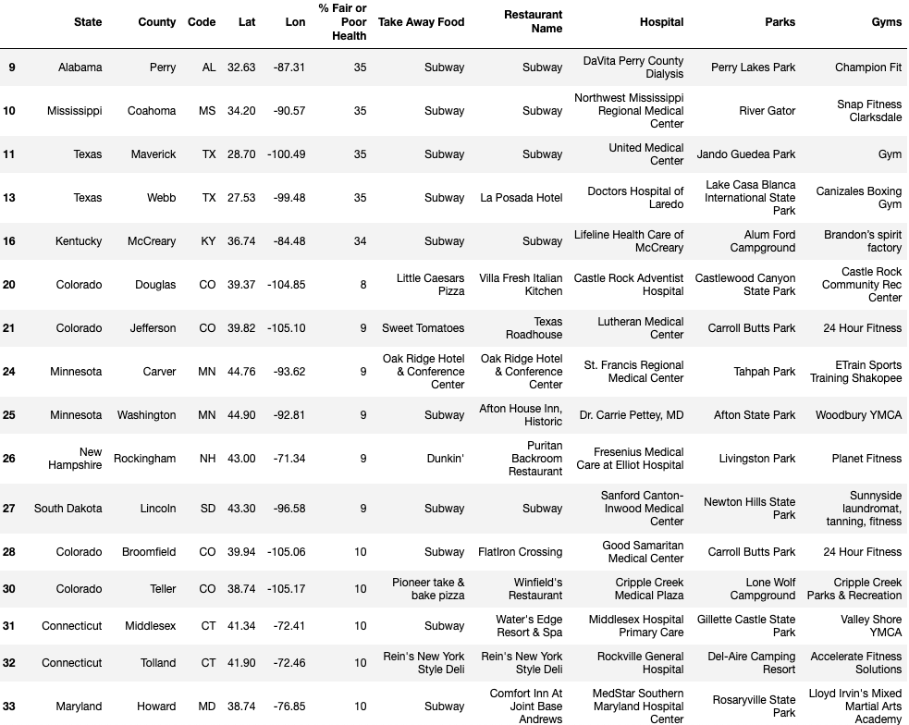

Slide 12
Data Cleanup & Exploration
Notes:
After determining sources, had to bring all data together to perform desired analyses

Slide 13



Exploration & Cleanup Process
Understand
data
Narrow
focus
Prepare
data
Notes:
Understand data
County Health Rankings (CHR) had wealth of information
Hours spent reviewing documentation/asking additional questions
Definition of each datapoint
Meanings of ratios
How data were grouped for various analyses
Narrow focus
Continued to think about other comparisons but had to narrow focus
Defined scope that we could analyze within given timeframe
Decided to look at top and bottom 20 counties within U.S. based on % poor/fair health
Prepare data
Ranking assigned in CHR was not what we wanted to analyze
By state, not entire country
Tried looking for other sources with county-level ranking but didn’t find exactly what we wanted
Thought about creating our own ranking – possibility for future project
Stuck with CHR due to thoroughness and added state abbreviation and lat/lon
Following slides demonstrate the process of preparing the data

Slide 14
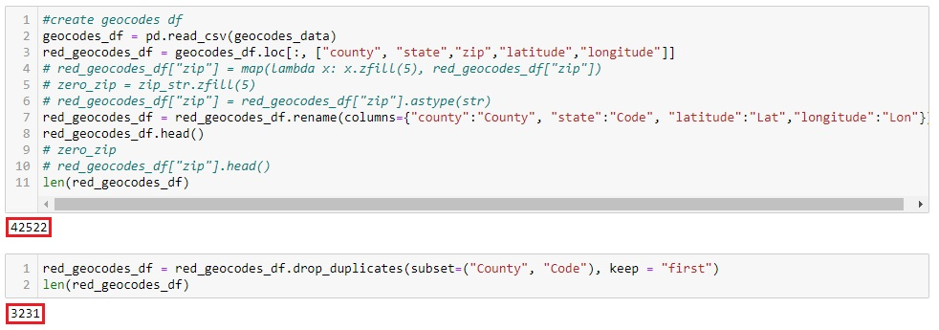
Prepare Data: Complete Data Set
Notes:
Initial Jupyter Notebook
Imported all CHR data saved as .csv into dataframe
Imported state abbreviation data into dataframe
Imported geocodes data into dataframe
Geodata challenges (demonstrated in this slide)
Tried to fix zip codes that began with “0s”
Determined not necessary
Selected geodata information had multiple lats/lons per county
Decided to drop duplicates and keep only the first
Filtered initial dataframe and kept only the datapoints we needed for our comparison
Dropped counties with NAs so we could get full set of data for all counties
Added state abbreviations via pd.merge
Added geocode data via pd.merge
Output file to CSV

Slide 15
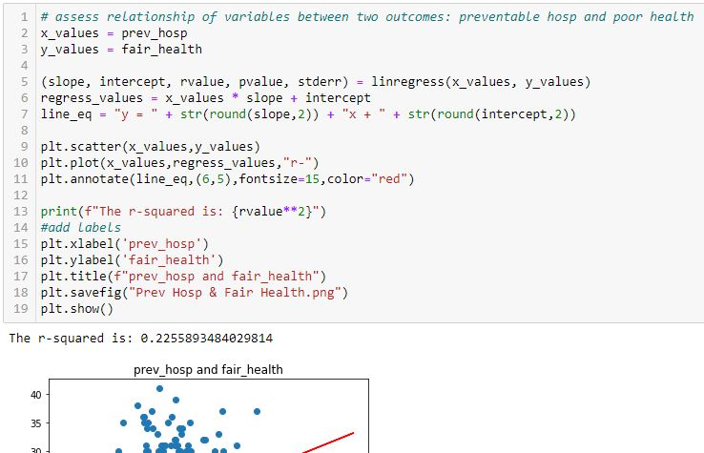
Prepare Data: Visualize Relationships
Notes:
Imported .csv created in first notebook into separate Jupyter Notebook for next team member to begin charting
Created variables for datapoints we wanted to analyze
Created scatter plot/linear regression analyses for each comparison to identify key takeaways
If more time, would have set up function for this so we didn’t have to copy/paste for each cell

Slide 16
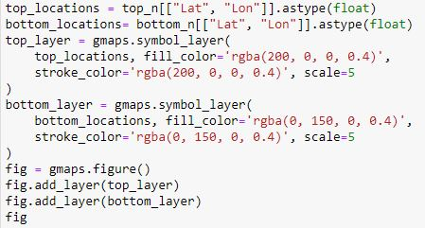
Prepare Data: Incorporate Google Places API
Notes:
Created separate Jupyter Notebook to map selected counties and determine if there was a geographical relationship
Idea was to get nearby restaurants, fast food, hospitals, gyms, etc. so we could identify if more access to these items affected poor/fair health
Did not work since we could only get nearest result
Created dataframe of top 20 counties then bottom 20 counties so we could apply specific colors to each

Slide 17
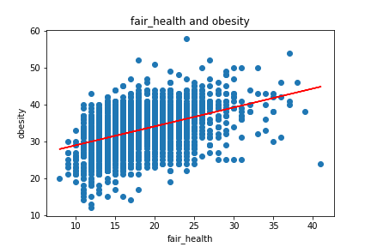
Unanticipated Insights
Weak correlation between fair health and obesity (.193)
Notes:
Initially overwhelmed by amount of data available for U.S. counties
Went through plethora of comparisons/analyses
Surprised by weak correlation between fair health and obesity
Obesity defined as adults reporting BMI >30
Respondents may not have been truthful or understood how to define themselves as obese

Slide 18
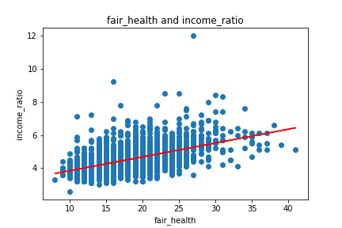
Unanticipated Insights
Weak correlation between fair health and income ratio (.286)
Notes:
Weak correlation between fair health and income ratio
Income ratio = ratio of household income at 80th percentile of median household income to income at the 20th percentile
Thought that there would be stronger correlation – lower ratio would see higher health since less of a gap

Slide 19
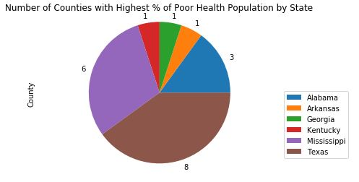
Unanticipated Insights
Poor health concentrated in southern states
Notes:
20 highest-ranking counties with poor health fell into 6 states

Slide 20
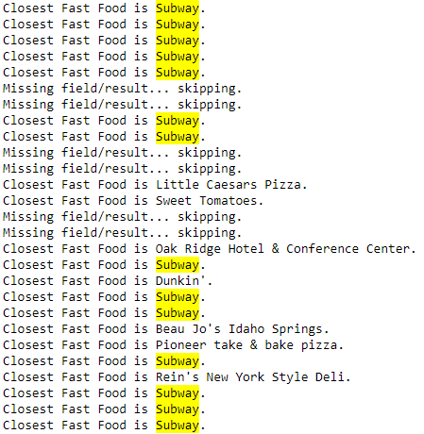
Unanticipated Insights
Subway was often the closest fast food.

Slide 21




Unanticipated Challenges
Data preparation
Initial data point
Accuracy of data
Task distribution
Notes:
Challenging to get data into desired format for analysis
Mentioned geodata challenges
Hard to stay focused - kept wanting to investigate other questions that arose during analysis
Wanted to show all of a certain place type in relation to county
“Nearby” just returns nearest place type
Would like to see if counties with higher fair health scores have more parks, gyms, health care providers, etc.
Previously mentioned that “Preventable Hospital Stays” limited to Medicare Enrollees
Could have looked for other data source to try to get this for entire population
Data accuracy
Were respondents truthful about alcohol consumption, obesity, mental/physical health, etc.?
Research tasks
Tried doing some research individually but kept regrouping because new questions arose
Found it more effective to assign certain tasks to each person then work through each as group
Assisted each other in real-time

Slide 22
Data Analysis
Notes:
After determining sources, had to bring all data together to perform desired analysis

Slide 23
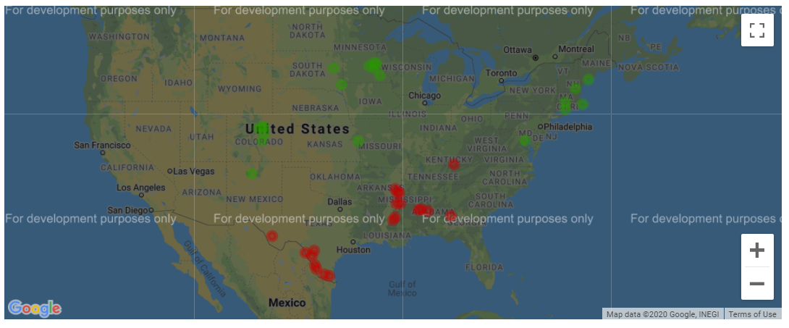
Top and Bottom counties for Health Outcomes

Slide 24
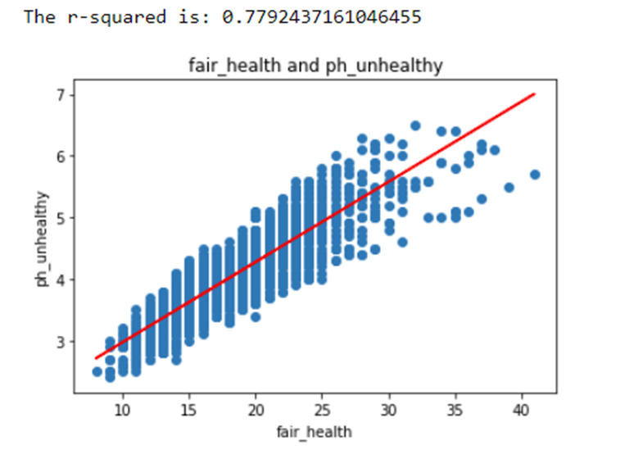
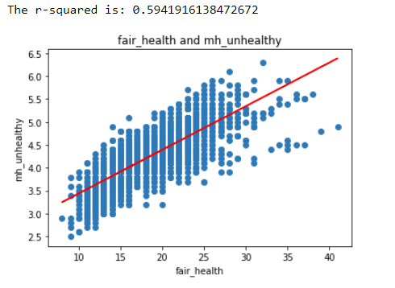
Poor Mental and Physical Health Days
Number of Physically Unhealthy Days
Number of Mentally Unhealthy Days
Notes:
The numerator is the number of adults who reported 14 or more days in response to the question, “Now, thinking about your mental health, which includes stress, depression, and problems with emotions, for how many days during the past 30 days was your mental health not good?”
The numerator is the number of adults who reported 14 or more days in response to the question, “Thinking about your physical health, which includes physical illness and injury, for how many days during the past 30 days was your physical health not good?”

Slide 25
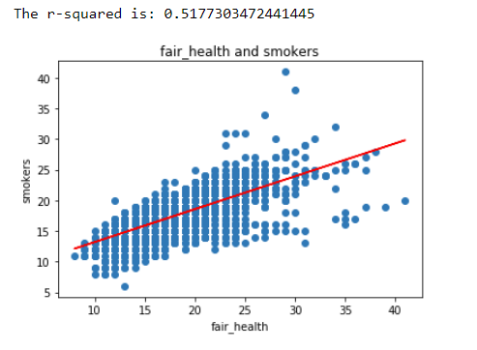
Smoking Rate and Poor or Fair Health Outcomes
Smoking: percentage of the adult population in a county who both report that they currently smoke every day or most days and have smoked at least 100 cigarettes in their lifetime.
Future analysis: smoking rates compared to mentally unhealthy days.

Slide 26
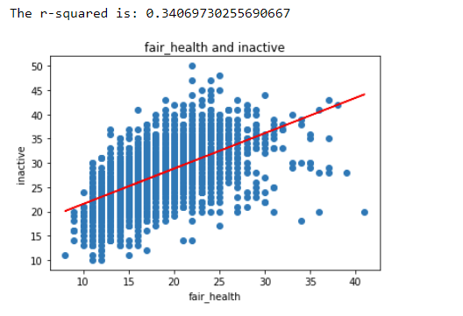
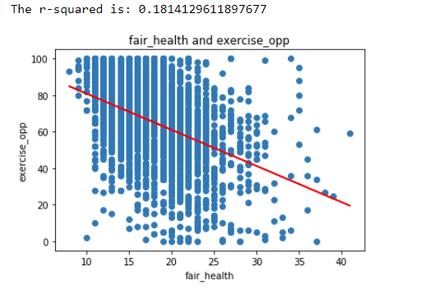
Physical Inactivity and Access to Exercise Opportunities
Physical Inactivity: no leisure-time physical activity in the past month
Access to Exercise Opportunities: individuals in a county who live reasonably close to a location for physical activity.
Future opportunities: walking scores, climate, elevation, season at time of survey, exercise and mentally unhealthy days.
Notes:
Physical Inactivity is based on responses to the Behavioral Risk Factor Surveillance Survey and is the percentage of adults ages 20 and over reporting no leisure-time physical activity in the past month.
Access to Exercise Opportunities measures the percentage of individuals in a county who live reasonably close to a location for physical activity. Locations for physical activity are defined as parks or recreational facilities. Individuals are considered to have access to exercise opportunities if they:
• reside in a census block that is within a half mile of a park, or • reside in an urban census block that is within one mile of a recreational facility, or • reside in a rural census block that is within three miles of a recreational facility.
The Walk Score site lets you insert any address and find the walkability of that location

Slide 27
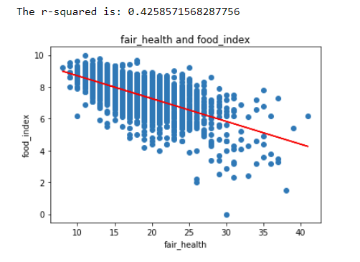
Food Deprivation Index
Definition: Limited Access to Healthy Foods measures the percentage of the population that is low income and does not live close to a grocery store.
Future Analysis: prevalence of fast food and unhealthy food options

Slide 28
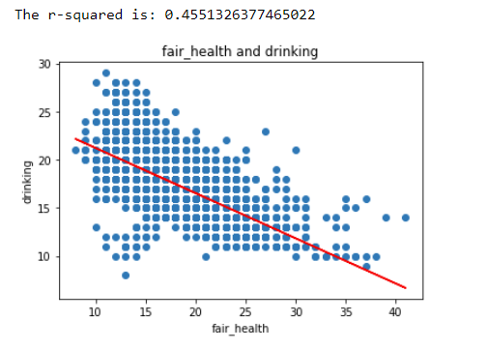
Excessive Drinking and Poor or Fair Health Outcomes
Excessive Drinking: the percentage of a county’s adult population that reports binge or heavy drinking in the past 30 days.
Future analysis: Liquor store locations from Google API, comparison of excessive drinking and mental unhealthy days.
Notes:
The Behavioral Risk Factor Surveillance System (BRFSS) is a state-based random digit dial (RDD) telephone survey that is conducted annually in all states, the District of Columbia, and U.S. territories. Data obtained from the BRFSS are representative of each state’s total non-institutionalized population over 18 years of age and have included more than 400,000 annual respondents with landline telephones or cellphones since 2011.

Slide 29
Questions?

Slide 30
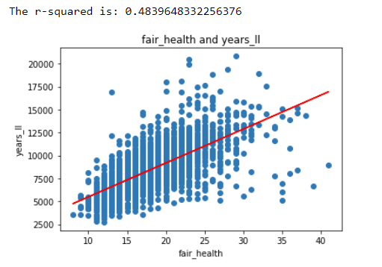

Slide 31
Post Mortem
Discuss any difficulties that arose, and how you dealt with them
Discuss any additional questions that came up, but which you didn't have time to answer: What would you research next, if you had two more weeks?
Data source for preventable hospitalizations was Medicare, could be skewing the data
Most of the behavioral data is gathered via a phone survey and is self reported, which can lead to bias issues.
Prevalence of unhealthy food, access to liquor stores

